Slide 1
Costa coffee
WID hackathon

Slide 2
hypothesis
There is a lack of education in 18-24yo about what constitutes sexual violence in the private sphere which leads to a lack of reporting.
Sexual violence:
Sexual touching
FGM
Rape
Forced sex
Physical assault

Slide 3
Private sexual violence crimes
 | Don’t Consider |  |  | Experienced |  |  | Reported
CRIME | Average | 18-24yo | Diff | Average | 18-24yo | Diff | Average | 18-24yo | Diff
PHYSICAL ASSAULT | 22.9% | 16.0% | -6.9% | 6.5% | 14.4% | 7.9% | 1.2% | 2.2% | 1.0%
FORCED SEX | 9.4% | 14.1% | 4.7% | 7.0% | 15.4% | 8.4% | 0.6% | 2.2% | 1.6%
RAPE | 6.3% | 12.5% | 6.2% | 5.5% | 11.5% | 6.0% | 0.7% | 3.2% | 2.5%
18-24yos, on average, are less likely to consider these severe offences as crimes.
They are also much more likely to experience these crimes.
There’s a significant drop off in % of 18-24yos that experience these crimes, that go on to report them.
Note: wanted to look into link between higher online presence of 18-24yos and the normalisation of misogyny in these spaces, in order to see if this is driving the lack of understanding of crimes.

Slide 4
Sexual violence in public and private space
 | Private |  |  | Public
Crime | Average | 18-24yo | Diff | Average | 18-24yo | Diff
Physical assault | 23% | 16% | -7% | 19% | 16% | -3%
Sexual touching | 21% | 25% | 4%
FGM | 10% | 14% | 4%
Force sex | 9% | 14% | 5% | 8% | 17% | 8%
Rape | 6% | 13% | 6% | 6% | 13% | 7%
CONSIDERCRIME_PUBLIC_RAPE |  | Diff
18-24 | 13%
Asian | 29% | 16%
Black | 19% | 6%
Mixed | 8% | -5%
Other | 0% | -13%
White | 9% | -4%
CONSIDERCRIME_PRIVATE_RAPE |  | Diff
18-24 | 13%
Asian | 23% | 10%
Black | 19% | 6%
Mixed | 8% | -5%
Other | 0% | -13%
White | 10% | -3%
Asian and black 18-24yos significantly over-index in not considering sexual violence a crime, in both private and public spaces.

Slide 5
Religious Harassment – Crime consideration
There is a high %pt difference between age demographics considering it as a crime across all three areas (private/public/online), with 65+ having the highest proportion of people NOT considering it to be a crime.
There is an over-index in the Northern Ireland region, with East Midlands, East of England, South West and Wales also showing higher results for not considering it a crime within this age group.
 | 18-24 | 25-34 | 35-44 | 45-54 | 55-64 | 65+ | Overall
CONSIDERCRIME_ONLINE_RELIGIOUS | 36.9% | 32.7% | 26.7% | 23.3% | 28.7% | 38.1% | 30.3%
CONSIDERCRIME_PRIVATE_RELIGIOUS | 36.2% | 29.8% | 24.3% | 24.5% | 32.5% | 42.8% | 30.8%
CONSIDERCRIME_PUBLIC_RELIGIOUS | 35.3% | 27.3% | 20.3% | 22.3% | 27.9% | 41.6% | 28.1%
 | East Midlands | East of England | London | North East | North West | Northern Ireland | Scotland | South East | South West | Wales | West Midlands | Yorkshire And The Humber
CONSIDERCRIME_ONLINE_RELIGIOUS | 44.2% | 47.1% | 27.3% | 37.5% | 31.1% | 60.0% | 41.1% | 21.7% | 60.0% | 45.2% | 32.4% | 34.0%
CONSIDERCRIME_PRIVATE_RELIGIOUS | 51.2% | 48.6% | 36.4% | 29.2% | 41.0% | 60.0% | 39.3% | 41.3% | 50.0% | 45.2% | 38.2% | 39.6%
CONSIDERCRIME_PUBLIC_RELIGIOUS | 44.2% | 40.0% | 27.3% | 45.8% | 37.7% | 70.0% | 37.5% | 41.3% | 50.0% | 51.6% | 38.2% | 41.5%

Slide 6
Homophobic Harassment- Crime Consideration
18-24 age group had the highest proportion of people NOT considering homophobic harassment a crime.
 | 18-24 | 25-34 | 35-44 | 45-54 | 55-64 | 65+ | Overall
CONSIDERCRIME_ONLINE_HOMOPHOBIC | 37.2% | 29.3% | 22.0% | 19.8% | 23.0% | 30.7% | 26.0%
CONSIDERCRIME_PRIVATE_HOMOPHOBIC | 34.3% | 28.0% | 20.8% | 20.3% | 26.0% | 32.1% | 26.1%
CONSIDERCRIME_PUBLIC_HOMOPHOBIC | 32.7% | 25.2% | 16.9% | 17.6% | 22.0% | 29.4% | 23.0%

Slide 7
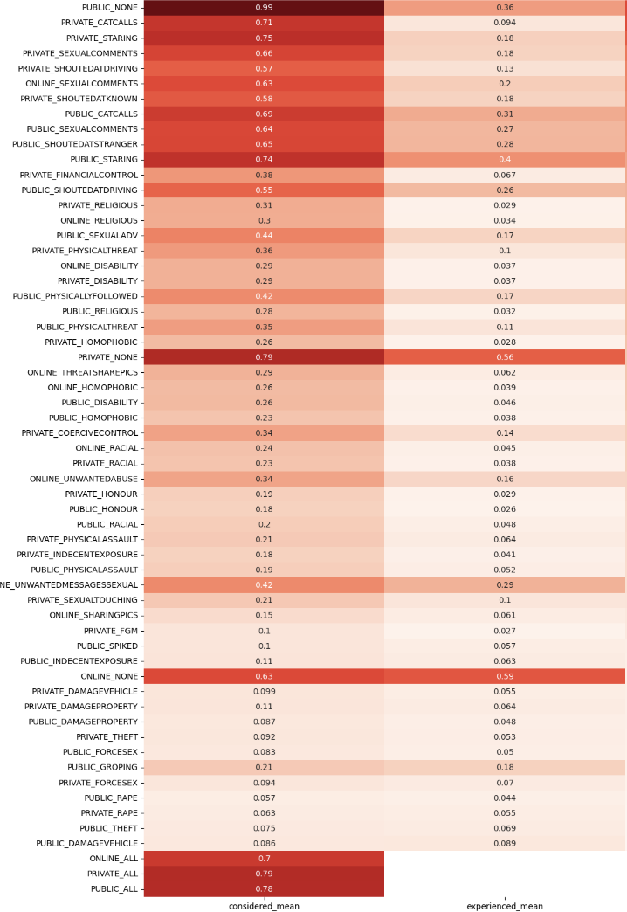
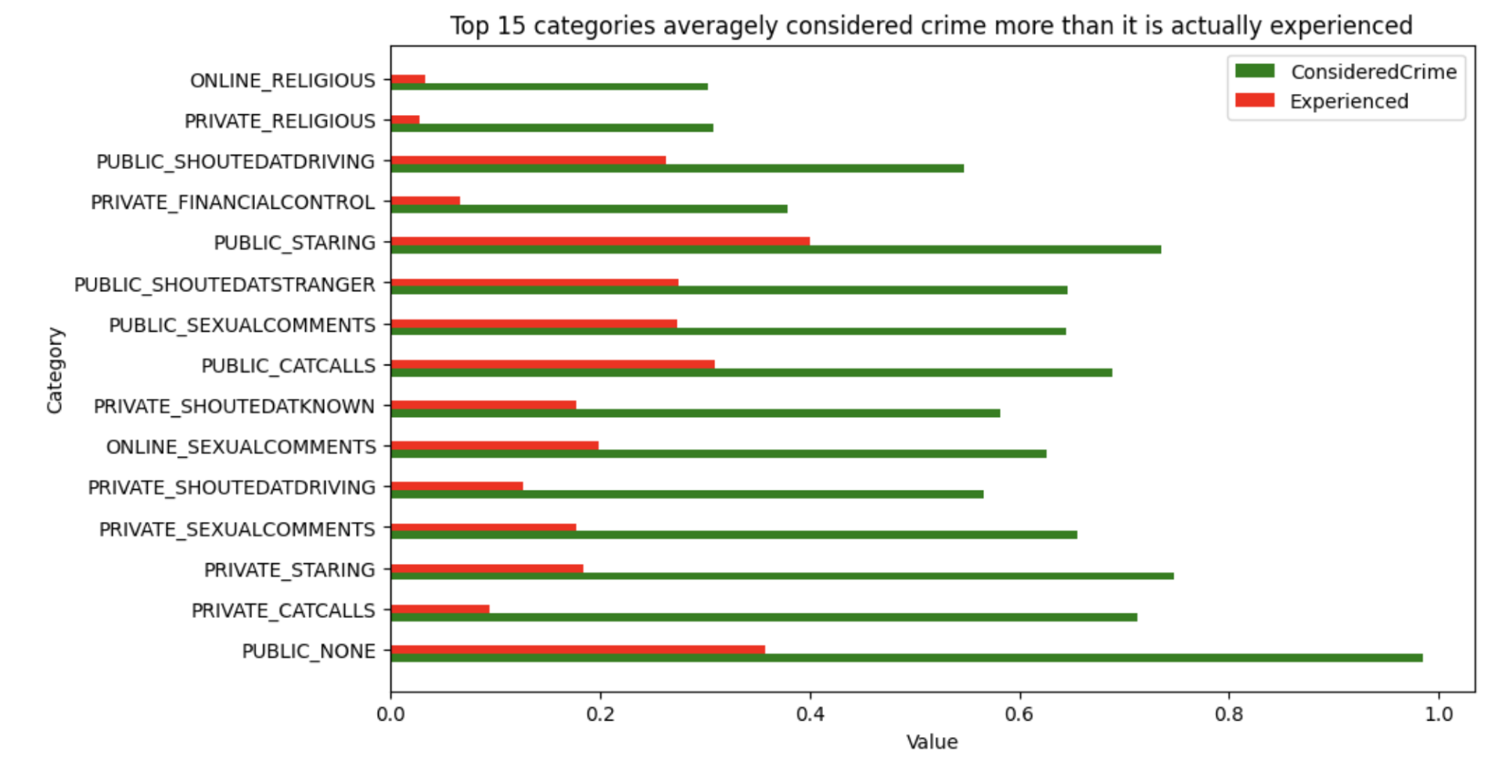
The analysis compared average scores for offenses considered as crimes versus those experienced by respondents, identifying the top 15 categories with the biggest discrepancies (Plot 1). These categories also represent offenses experienced at a higher rate. However, the 'Public/Private Rate', despite being experienced less frequently, is still considered a crime by fewer people (Plot 2). Further exploration is warranted given the limited timeframe.

